Slide 1
INVESTMENT CASE STUDY SUBMISSION
Group Name: Abraca-Data
Meenali Sharma
Venkitachalam Ramaswamy
Ankit Sahu
Vikul Aggarwal

Slide 2
Abstract
Spark Funds, an asset management company, wants to make investments in a few companies. Before investment decisions are made, there is a need to understand the global trends in investments.
The Strategy
To invest where most other investors are investing
The business objective
To identify the best sectors, countries, and a suitable investment type for making investments.
Goals of data analysis
Investment type analysis –To identify the best investment type among venture, seed, angel, and private equity categories with an investment of 5 to 15 million USD per round.
Country analysis–To identify the countries with the maximum amount of investment.
Sector analysis –To identify the sectors with the most number of investments.

Slide 3
Problem solving methodology
Companies Data
Merge
Funding Type Analysis
Master Data
Top Funding type
Investment rounds Data
Top Funding Type Data
Merge
Sector Mapped Data Frame
Sector Mapping Data
Country
Analysis
Sector Analysis
Top 9 Countries Data Frame
Top companies
Top sector for investment
Top 3 countries’ Data Frame
Top 3 countries for investment

Slide 4
Funding Type Analysis
The average investment amount in USD for each of the 4 funding types
Since there is a constraint of raised amount to be between 5 to 15 million USD per investment round,
the preferred type of investment is Venture.
Investment Type | Average investment amount (million USD)
Venture | 11.75
Angel | 0.96
Seed | 0.72
Private Equity | 73.31

Slide 5
Country Analysis
The top 9 countries which have received the highest total funding across all sectors for ‘Venture’ investment type
The top 3 most investment-friendly countries for ‘Venture’ investment are
United States, United Kingdom and India
Country | Total Investment (million USD) | Is English an official Language?
United States (USA) | 422510.84 | Y
China (CHN) | 39835.42 | N
United Kingdom (GBR) | 20245.63 | Y
India (IND) | 14391.86 | Y
Canada (CAN) | 9583.33 | Y
France (FRA) | 7259.54 | N
Israel (ISR) | 6907.51 | N
Germany (DEU) | 6346.96 | N
Japan (JPN) | 3363.68 | N

Slide 6
Sector Analysis
Sector-wise investment details for the top 3 investment friendly countries for Venture investment type
Main Sector | Number of Investments | Total Amount Invested (million USD) | To*p company
United States
Others | 2950 | 108531.35 | Virtustream
Social, Finance, Analytics, Advertising | 2714 |  | SST Inc. (Formerly ShotSpotter)
Cleantech / Semiconductors | 2350 |  | Biodesix
United Kingdom
Others | 147 | 5436.84 | Electric Cloud
Social, Finance, Analytics, Advertising | 133 |  | Celltick Technologies
Cleantech / Semiconductors | 130 |  | EUSA Pharma
India
Others | 110 | 2976.54 | FirstCry.com
Social, Finance, Analytics, Advertising | 60 |  | Manthan Systems
News, Search and Messaging | 52 |  | GupShup

Slide 7
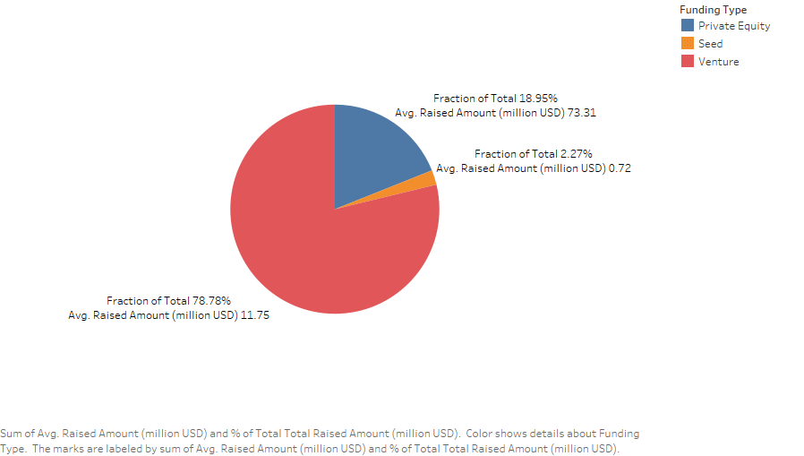
Funding Type Plot

Slide 8
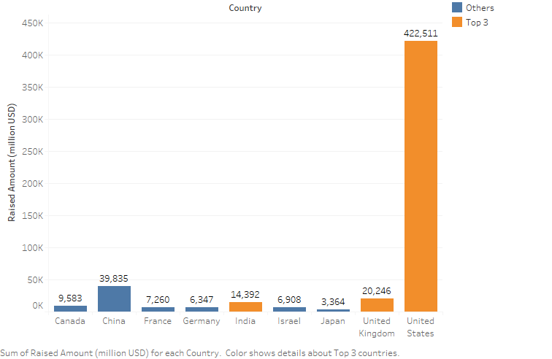
Country Analysis Plot

Slide 9
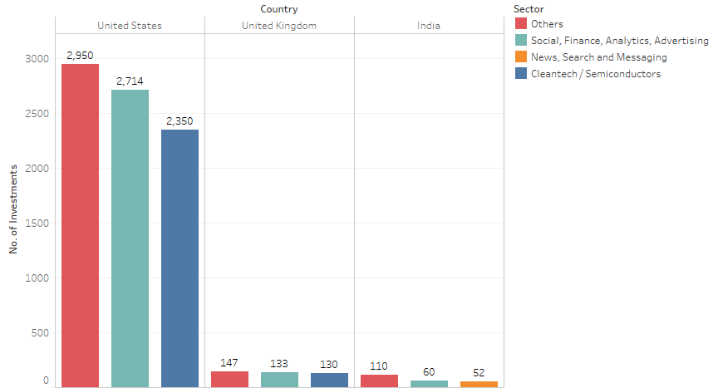
Sector Analysis Plot

Slide 10
Conclusions
Recommended Funding type: Venture
Top 3 English-speaking, investment friendly countries: Unite States, United Kingdom and India
The top 3 sectors to invest in each country
The top 2 companies with highest investment in the past
United States | United Kingdom | India
Others | Others | Others
Social, Finance, Analytics, Advertising | Social, Finance, Analytics, Advertising | Social, Finance, Analytics, Advertising
Cleantech / Semiconductors | Cleantech / Semiconductors | News, Search and Messaging
Sector/Country | United States | United Kingdom | India
Others | Virtustream | Electric Cloud | FirstCry.com
Social, Finance, Analytics, Advertising | SST Inc. (Formerly ShotSpotter) | Celltick Technologies | Manthan Systems

